Slide 1

Artificial Intelligence: A Modern Approach
Fourth Edition, Global Edition
Chapter 11
Automated Planning
© 2022 Pearson Education Ltd.

Slide 2
Outline
Definition of Classical Planning
Algorithms for Classical Planning
Heuristics for Planning
Hierarchical Planning
Planning and Acting in Nondeterministic Domains
Time, Schedules, and Resources
Analysis of Planning Approaches
© 2022 Pearson Education Ltd.

Slide 3
Definition of Classical Planning
Classical planning is defined as the task of finding a sequence of actions to accomplish a goal in a discrete, deterministic, static, fully observable environment.
Planning Domain Definition Language (Ghallab et al., 1998). PDDL is a factored representation.
Basic PDDL can handle classical planning domains, and extensions can handle non-classical domains that are continuous, partially observable, concurrent, and multi-agent.
State: represented as a conjunction of ground atomic fluents
uses database semantics: the closed-world assumption means that any fluents that are not mentioned are false
© 2022 Pearson Education Ltd.

Slide 4
Definition of Classical Planning
An action schema represents a family of ground actions
The schema consists of the action name, a list of all the variables used in the schema, a precondition and an effect.
Action(Fly(p, from, to),
PRECOND: At(p, from) ∧ Plane(p) ∧Airport(from) ∧ Airport(to)
EFFECT: ¬At(p, from) ∧ At(p, to))
A set of action schemas serves as a definition of a planning domain. A specific problem within the domain is defined with the addition of an initial state and a goal
The initial state is a conjunction of ground fluents
The goal is just like a precondition: a conjunction of literals (positive or negative) that may contain variables

Slide 5
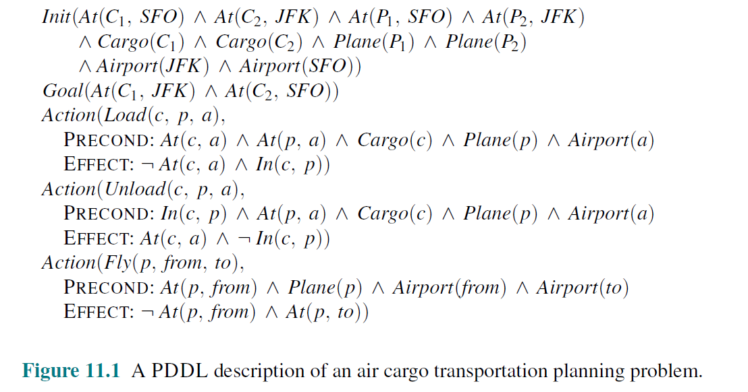
Definition of Classical Planning

Slide 6
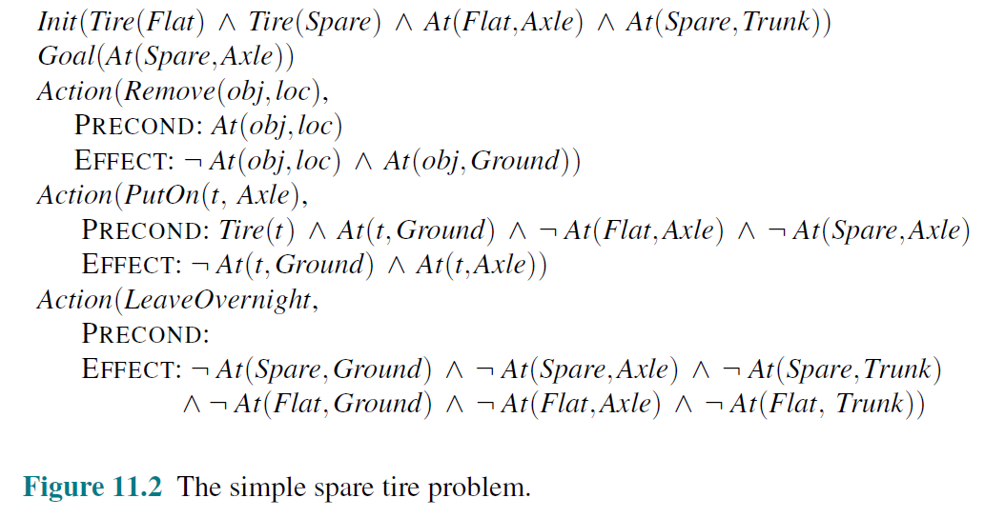
Definition of Classical Planning

Slide 7
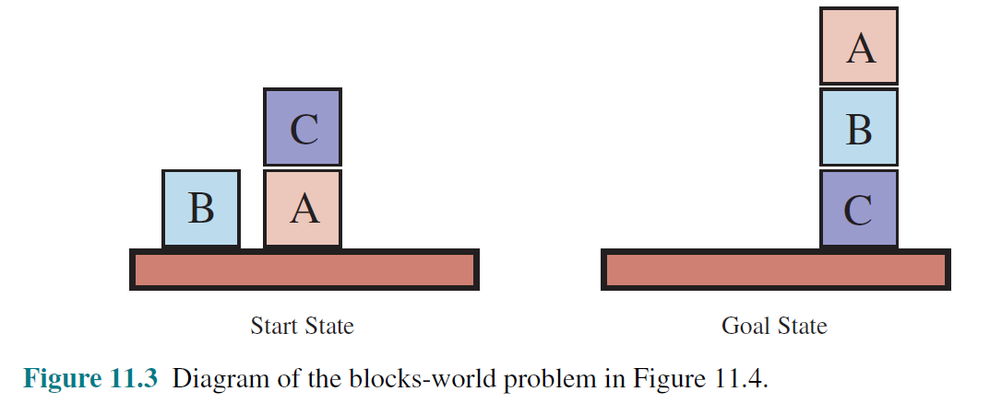
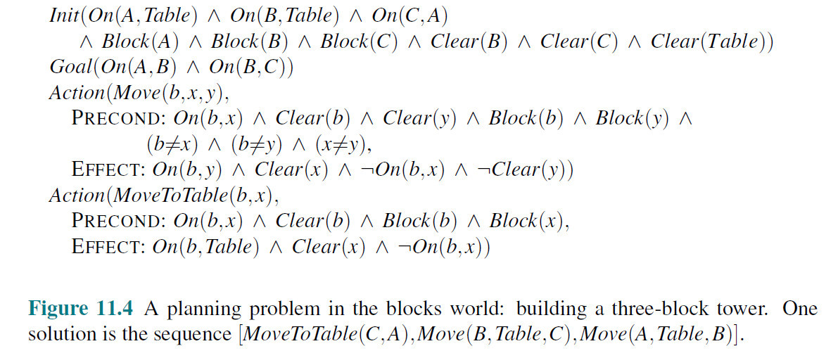
Definition of Classical Planning

Slide 8
Algorithms for Classical Planning
Forward state-space search for planning
Start at initial state
To determine the applicable actions we unify the current state against the preconditions of each action schema
For each unification that successfully results in a substitution, we apply the substitution to the action schema to yield a ground action with no variables.
Backward search for planning
Start at the goal and apply the actions backward until we find a sequence of steps that reaches the initial state
Consider relevant actions at each step.
Reduces branching factor
A relevant action is one with an effect that unifies with one of the goal literals, but with no effect that negates any part of the goal.

Slide 9
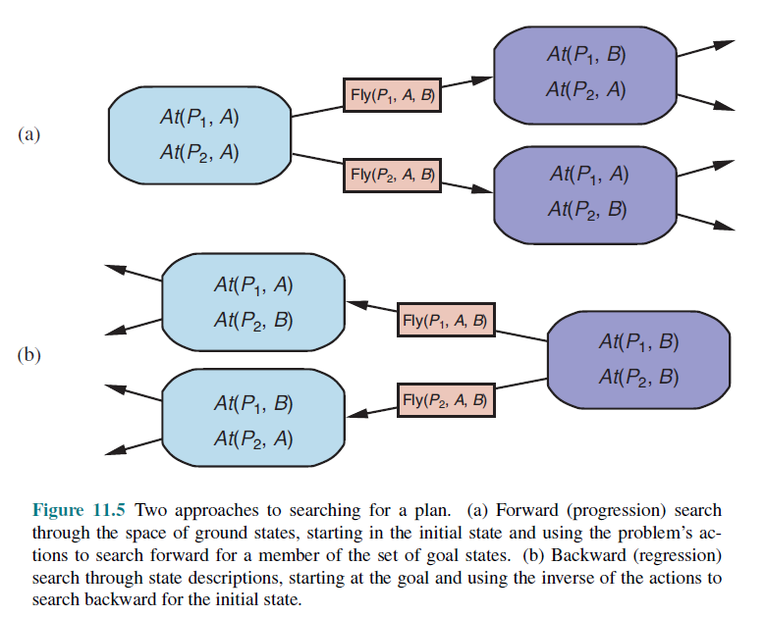
Algorithms for Classical Planning

Slide 10
Algorithms for Classical Planning
Other classical planning approaches
An approach called Graph plan uses a specialized data structure, a planning graph
Situation calculus is a method of describing planning problems in first-order logic
An alternative called partial-order planning represents a plan as a graph rather than a linear sequence:
each action is a node in the graph,
for each precondition of the action there is an edge from another action (or from the initial state) that indicates that the predecessor action establishes the precondition.

Slide 11
Heuristics for Planning
Ignore preconditions heuristic: drops all preconditions from actions
Every action becomes applicable
Ignore-delete-lists heuristic: removing the delete lists from all actions (i.e., removing all negative literals from effects).
Domain-independent pruning
symmetry reduction: prune out consideration all symmetric branches of the search tree except for one
forward pruning: might prune away an optimal solution
relaxed plan: solution to a relaxed problem
preferred action: step of the relaxed plan, or it achieves some precondition of the relaxed plan

Slide 12
Heuristics for Planning
State abstraction in planning
state abstraction: a many-to-one mapping from states in the ground representation of the problem to the abstract representation
relaxations that decrease the number of states
decomposition: dividing a problem into parts, solving each part independently, and then combining the parts
Subgoal independence assumption: the cost of solving a conjunction of subgoals is approximated by the sum of the costs of solving each subgoal independently
The subgoal independence assumption can be optimistic or pessimistic
optimistic: negative interactions between the subplans for each subgoal
pessimistic: inadmissible, when subplans contain redundant actions

Slide 13
Hierarchical Planning
Higher levels of abstraction with hierarchical decomposition to manage complexity
Hierarchical structure reduces computational task to a small number of activities at the next lower level.
Computational cost of finding the correct way to arrange those activities for the current problem is small.
High level actions (HLA):
Hierarchical task networks or HTN planning
Assume full observability & determinism & primitive actions standard precondition-effect schemas
HLA offers one or more possible refinements into a sequence of actions.
Implementation of HLA: An HLA refinement that contains only primitive actions.
High level plan (HLP)
is the concatenation of implementations of each HLA in the sequence.
a high-level plan achieves the goal from a given state if at least one of its implementations achieves the goal from that state

Slide 14
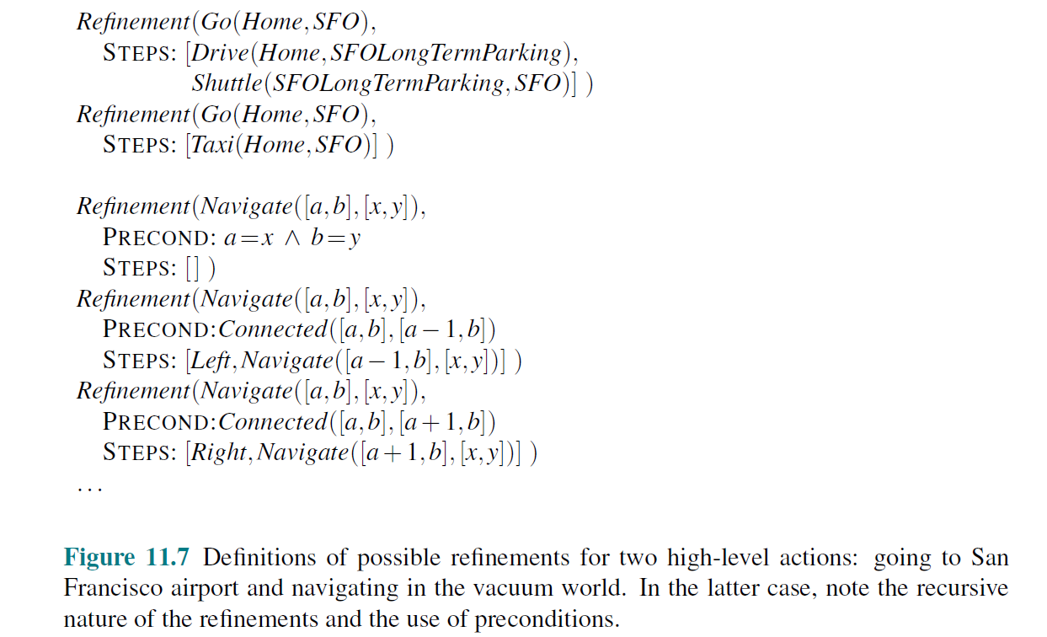
Hierarchical Planning
Example of Refinement

Slide 15
Planning and Acting in Nondeterministic Domains
Sensorless planning
open-world assumption in which states contain both positive and negative fluents, and if a fluent does not appear, its value is unknown
given belief state b, the agent can consider any action whose preconditions are satisfied by b.
assume that the initial belief state is always a conjunction of literals, that is, a 1-CNF formula
To construct the new belief state b’, we must consider what happens to each literal l in each physical states in b when action a is applied.
What about a literal whose truth value is unknown in b? There are three cases:
If the action adds l, then l will be true in b’ regardless of its initial value.
If the action deletes l, then l will be false in b0 regardless of its initial value.
If the action does not affect , then l will retain its initial value (which is unknown) and will not appear in b’.

Slide 16

Planning and Acting in Nondeterministic Domains
Sensorless planning
Conditional effect: an actions effect is dependant on a state (eg: robot’s location)
“when condition: effect,” where condition is a logical formula to be compared against the current state, and effect is a formula describing the resulting state.
When applied to the initial belief state True, the resulting belief state is (AtL ∧ CleanL) ∨ (AtR ∧ CleanR), which is no longer in 1-CNF.
All conditional effects whose conditions are satisfied have their effects applied to generate the resulting belief state; if none are satisfied, then the resulting state is unchanged.

Slide 17
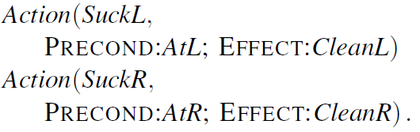
Planning and Acting in Nondeterministic Domains
Sensorless planning
if a precondition is unsatisfied, then the action is inapplicable and the resulting state is undefined.
it is better to have conditional effects than an inapplicable action
split Suck into two actions with unconditional effects as follows:
so the belief states all remain in 1-CNF

Slide 18
Planning and Acting in Nondeterministic Domains
Contingent planning
The generation of plans with conditional branching based on percepts—is appropriate for environments with partial observability, nondeterminism, or both
When executing this plan, a contingent-planning agent can maintain its belief state as a logical formula
Evaluate each branch condition by determining if the belief state entails the condition formula or its negation

Slide 19
Planning and Acting in Nondeterministic Domains
Online planning
The need for a new plan: execution monitoring
When there are too many contingencies to prepare for
When a contingency is not prepared for replanning is required
Replanning is needed if the agent’s model of the world is incorrect (missing precondition, effect or fluent)
For online planning an agent monitor based on three approaches.
Action monitoring: before executing an action, the agent verifies that all the preconditions still hold.
Plan monitoring: before executing an action, the agent verifies that the remaining plan will still succeed.
Goal monitoring: before executing an action, the agent checks to see if there is a better set of goals it could be trying to achieve.

Slide 20
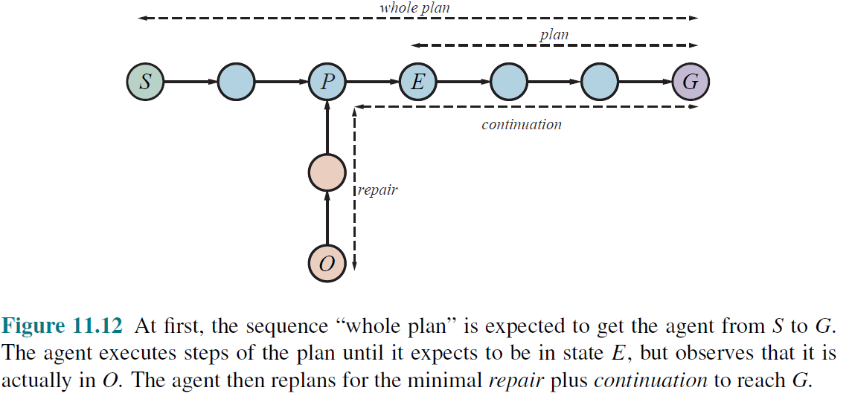
Planning and Acting in Nondeterministic Domains
Online planning (example)

Slide 21
Time, Schedules, and Resources
Classical planning talks about what to do, in what order, but does not talk about time: how long an action takes and when it occurs
However the real world has resource constraints
Representing temporal and resource constraints
Actions can have a duration and constraints
Constraints:
Type of resource
Number of resources
Resource is consumable or reusable
Aggregation: representation of resources as numerical quantities
The representation of resources as numerical quantities, such as Inspectors(2), rather than as named entities, such as Inspector(I₁) and Inspector(I₂),
This reduces complexity if multiple quantities are used

Slide 22
Time, Schedules, and Resources
Solving scheduling problems
Graph problems
Uses critical path method (CPM) to determine the possible start and end times of each action
A path through a graph representing a partial-order plan is a linearly ordered sequence of actions beginning with Start and ending with Finish.
The critical path is that path whose total duration is longest; the path is “critical” because it determines the duration of the entire plan
Actions that are off the critical path have a window of time in which they can be executed.
This window of time is known as Slack. The window has a earliest possible start time ES and latest possible start time LS
Together the ES and LS times for all the actions constitute a schedule for the problem.

Slide 23
Time, Schedules, and Resources
Many approaches have been tried for optimal scheduling including branch-and-bound, simulated annealing, tabu search, and constraint satisfaction.
Eg: minimum slack heuristic:
on each iteration, schedule for the earliest possible start whichever unscheduled action has all its predecessors scheduled and has the least slack; then update the ES and LS times for each affected action and repeat.
It is a greedy heuristic
Resembles minimum-remaining-values (MRV) heuristic in constraint satisfaction.

Slide 24
Analysis of Planning Approaches
Planning combines the two major areas of AI we have covered so far: search and logic.
Combination allows planners to scale up from toy problems where the number of actions and states as limited to around a dozen, to real-world industrial applications with millions of states and thousands of actions.
Planning helps in controlling combinatorial explosion through the identification of independent subproblems.
Unfortunately, we do not yet have a clear understanding of which techniques work best on which kinds of problems.
Newer techniques will emerge that provide highly expressive first-order and hierarchal representations
Eg: portfolio planning systems, where a collection of algorithms are available to apply to any given problem

Slide 25
Summary
PDDL, the Planning Domain Definition Language, describes the initial and goal states as conjunctions of literals, and actions in terms of their preconditions and effects
Hierarchical task network (HTN) planning allows the agent to take advice from the domain designer in the form of high-level actions (HLAs) that can be implemented in various ways by lower-level action sequences.
Contingent plans allow the agent to sense the world during execution to decide what branch of the plan to follow.
An online planning agent uses execution monitoring and splices in repairs as needed to recover from unexpected situations, which can be due to nondeterministic actions, exogenous events, or incorrect models of the environment
Many actions consume resources, such as money, gas, or raw materials

